Slide 1
Tools for Embedded System Programming
NTNU, 2023/10/10
Christian Fensch <christian.fensch@arm.com>

Slide 2
Acknowledgements and Disclaimer
These slides are based on a lecture taught by my former colleague Guus Sliepen
The view expressed here are my personal views and may not reflect ARM’s views

Slide 3
Overview
About tools in general
Tools for creating software
Tools for quality control
Tools for debugging
Tools for continuous integration

Slide 4
About Tools in General

Slide 5
Our Goals
We are writing software that must:
Do what it is supposed to do
Not have bugs
Handle all possible use cases/inputs
Be performant
Tools help us do this faster and better.

Slide 6
About Tools
Professionals rely heavily on tools.
Make sure you know your tools.
Find tools and practice with them.
Use the right tool for a given task.
There are different kinds of tools:
Commercial or Free/Open Source tools.
Off-the-shelf or self-made tools.
Tools can be used stand-alone or combined (automation).
There are good and bad tools.
There are tools to make tools.

Slide 7

Problem Statement
You don't want to screw this in without a tool.

Slide 8

This is a Tool

Slide 9

But, Maybe not the Right Tool…

Slide 10

Some tools can be used in a pinch

Slide 11

The Right Tool for this Job

Slide 12

Powertool for this Job
Repetitive tasks will benefit from automation.

Slide 13
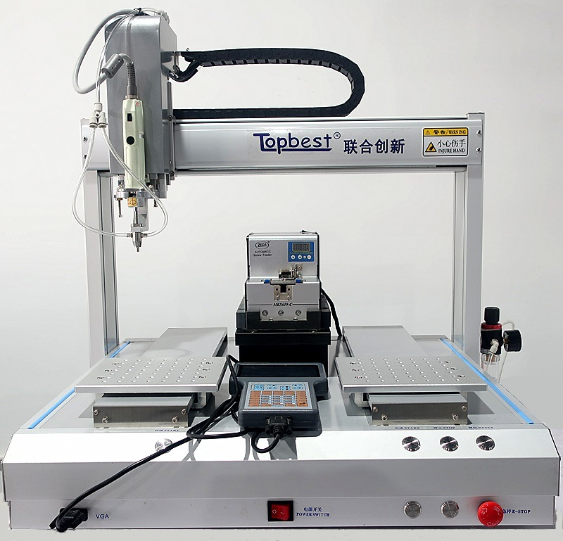
Automating Everything

Slide 14
Tools for Creating Software

Slide 15
Code editors and IDEs
These help you write source code efficiently.
Common functions:
Syntax highlighting
Tab-completion
Quick navigation
Integration with build system, debugger
Well-known examples:
Vim
GNU Emacs
Eclipse
Microsoft Visual Studio
Android Studio

Slide 16
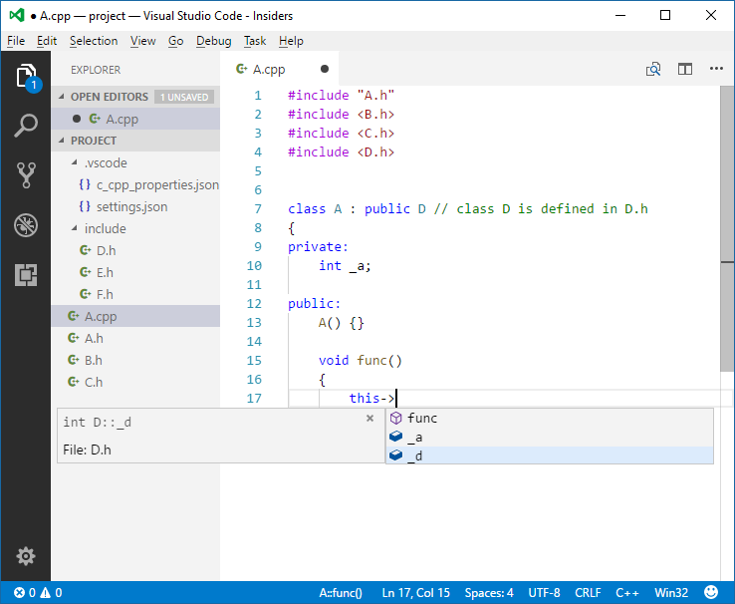
Code Editors and IDEs

Slide 17
Compilers
Common functions:
Supporting language standards
Optimizing your code (for size or speed)
Warning about bad/undefined behaviour
Instrumenting code (see later)
Well-known examples:
GCC
Clang/LLVM
Microsoft Visual C++
Intel ICC

Slide 18
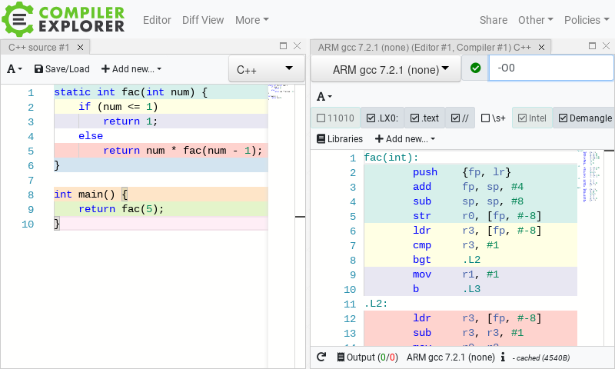
Compiler Explorer
https://godbolt.org/

Slide 19
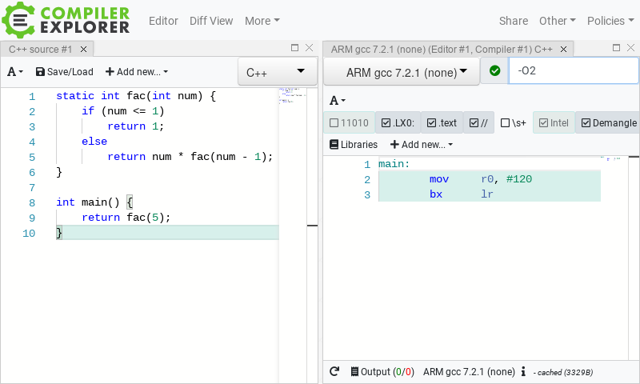
Compiler Explorer
https://godbolt.org/

Slide 20
Listen to Your Compiler Warnings
#include <stdio.h> int main() { const int values[] = {1, 2, 3, 4, 5}; for (int i = 0; i <= 5; i++) printf("%d\n", values[i]); }
>gcc -o test test.c -O -Wall test.c: In function ‘main’: test.c:7:9: warning: iteration 5 invokes undefined behavior [-Waggressive-loop-optimizations] printf("%d\n", values[i]); ^~~~~~~~~~~~~~~~~~~~~~~~~ test.c:6:5: note: within this loop for (int i = 0; i <= 5; i++) ^~~

Slide 21
Build Systems
These take care invoking the compiler and other tools for you.
Common functions:
Start builds, tests, packaging, flashing
Avoid repeating unnecessary steps
Allow configurable builds (debug, release)
Find dependencies
Take care of differences in platforms (OS, CPU architecture)
Well-known examples:
GNU Autotools
CMake
Meson
Buildroot
Scons

Slide 22
Example Build Systems
GNU Autotools
./configure --prefix=/usr --enable-some-function … ./configure --host=arm-none-gnueabi # cross-compile make make dist # builds .tar.gz file make check # runs test suite make install # installs the software

Slide 23
Version Control Systems
These track changes in your source code over time.
Common functions:
Keep track of every change made
Allow multiple people working together frictionless
Support branching and merging
Synchronise with remote code repositories
Run other tools for every change (continuous integration)
Well-known examples:
git
Apache Subversion
Mercurial

Slide 24
Example git Commands
cd my-project git init # enables Git for your project git add *.c # stage all .c files git commit # commit staged files
git remote add origin https://github.com/me/my-project.git git push # push latest commits git pull # pull new commits git diff # show changes git log # show history
And much, much more …

Slide 25
Tools for Quality Control

Slide 26

Why Quality Control?
A way to prove the quality of your product
Gives you assurance that your changes do not cause regressions
Finds areas that can be improved

Slide 27
Static Code Analysers
These analyze your source code for potential errors:
Common functions:
Analyze every possible code path
Determine upper and lower bounds for variables
Check for possible out-of-bounds reads/writes
Check for possible NULL pointer dereferences
Check mismatching resource allocation/deallocation
Find dead code
Well-known examples:
Clang static analyzer
Cppcheck
Coverity

Slide 28
Example of Static Analysis
#include <stdio.h> void log_value(int value) { FILE *f = fopen("logfile.txt", "a"); fprintf(f, "%d\n", value); }
>cppcheck log_value.c Checking file.c ... [log_value.c:6]: (error) Resource leak: f

Slide 29
Run-Time Analysers
These analyze your software while it is running.
Common functions:
Check memory allocation/deallocation
Check out-of-bounds reads and writes
Check for use of uninitialized variables
Check for undefined behaviour
Keep track of which code is actually running
Measure cache misses
Well-known examples:
Valgrind
Compiler instrumentation (sanitizers, gprof, gcov)
Linux perf
Intel VTune

Slide 30
Example of Static Analysis
#include <stdlib.h> int main() { int *array = malloc(5 * sizeof(int)); for (int i = 0; i <= 5; i++) array[i] = i; }
>valgrind ./make-array ==32218== Memcheck, a memory error detector ==32218== ==32218== Invalid write of size 4 ==32218== at 0x109179: main (make-array.c:8) ==32218== Address 0x4a5e054 is 0 bytes after a block of size 20 alloc'd ==32218== at 0x48357BF: malloc (vg_replace_malloc.c:299) ==32218== by 0x109154: main (make-array.c:5)

Slide 31
Example of Profiling
#include <math.h> static volatile float in, out; float read_input() { return in; } void write_output(float val) { out = val; } float calculate(float val) { static float x = 0.1, y = 0.2, z = 0.3; x = sin(y) + val; y = pow(z, 2.0); z = fabs(x); return x + y + z; } void run_loop() { while(1) { float val = read_input(); val = calculate(val); write_output(val); } } int main() { run_loop(); }

Slide 32
Example of Profiling (cont.)
>perf record -g ./program >perf report
Samples: 60K of event 'cycles:ppp', Event count (approx.): 55494769147 Children Self Command Shared Object Symbol 59,99% 0,00% program [unknown] [.] 0x2b76258d4c544155 59,99% 0,00% program libc-2.27.so [.] __libc_start_main 59,99% 0,00% program program [.] main 55,60% 6,49% program program [.] run_loop 26,55% 26,54% program libm-2.27.so [.] __sin_fma 21,75% 21,73% program libm-2.27.so [.] __ieee754_pow_fma 20,06% 20,05% program program [.] calculate 14,32% 14,31% program libm-2.27.so [.] __pow 4,25% 4,25% program program [.] write_output 2,03% 2,03% program program [.] sin@plt 1,71% 1,71% program program [.] pow@plt 1,49% 1,49% program program [.] read_input 1,35% 1,35% program libm-2.27.so [.] @plt

Slide 33
Test Suites
Tests specifically designed to check your software.
Categories:
Unit tests
Integration tests
Performance tests
Well-known examples:
You write these!

Slide 34
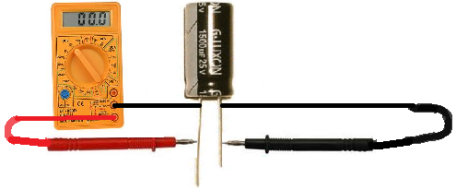
Unit Tests
Test the correctness of each class/function/module separately.
Give known input, compare against expected output.
Give wrong input, check error handling.
Make sure to test corner cases.
Tools that help you write unit tests:
CUnit, CppUnit
Cmocka
Google Test

Slide 35
Example Unit Test
#include <assert.h> unsigned int fac(unsigned int n) { return n <= 1 ? 1 : n * fac(n - 1); } int main() { assert(fac(0) == 1); assert(fac(1) == 1); assert(fac(2) == 2); assert(fac(3) == 6); assert(fac(10) == 3628800);
}

Slide 36
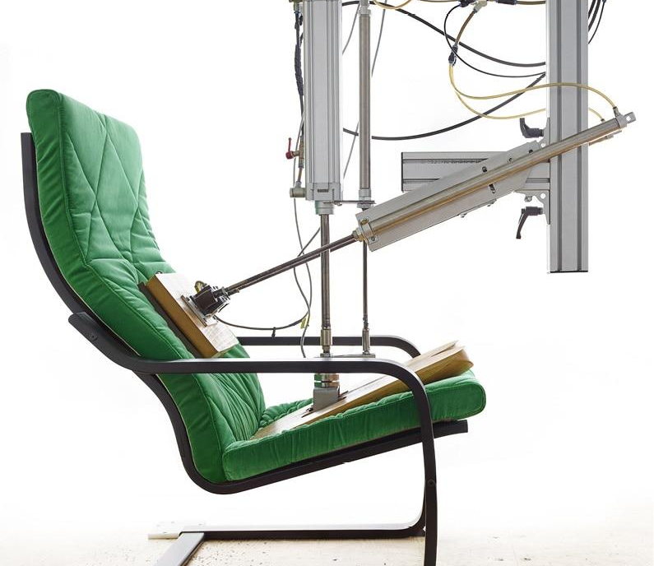
Integration Tests
Tests the function of your software as a whole.
Test real-world scenarios
Also test wrong input, error handling!
Regression tests
You can use the same tools as for unit tests.

Slide 37

Performance Tests
Test how well your program performs. Possible things to test:
Speed (throughput, latency)
Memory usage
I/O bandwidth usage
Cache misses
Power efficiency
Scalability
Tools that help you write performance tests:
Google Benchmark

Slide 38
Performance Tests
Make sure your performance benchmarks:
Are not optimized away by the compiler
Measure only the interesting parts
Do warm-up before measurement (cache, I/O, memory, branch predictors)
Run long enough to give a stable result (σ ≲ 0.1%)
Use hardware counters if available
Return absolute numbers
Bigger is better (or clearly mark when not)
Regressions are sometimes unavoidable, but that's OK.

Slide 39
Example of a Bad Performance Test
#include <stdio.h> #include <time.h>
unsigned int fac(unsigned int n) { return n <= 1 ? 1 : n * fac(n - 1); } int main() { time_t start = time(NULL); for (int i = 0; i < 100000; i++) fac(i); time_t end = time(NULL); printf("Test took %ld seconds.\n", end - start); }

Slide 40

YO DAWG I HEARD YOU LIKE TEST SUITES
SO YOU SHOULD MAKE A TEST SUITE
FOR YOUR TEST SUITE!

Slide 41
Code Coverage
Check that your tests actually test all the code your wrote. Possible levels:
All functions are tested
All lines are tested
All possible branch conditions are tested
Run your test suite with code coverage, add tests if you don't have 100% coverage. Well-known tools:
gcov
llvm-cov

Slide 42
Example of a Code Coverage Test
#include <assert.h> int foo(int a, int b, int c) { if (a > 0) return 1; else if (b > 0 || c > 0) return 2; else return 0; } int main() { assert(foo(0, 0, 0) == 0); assert(foo(1, 0, 0) == 1); assert(foo(0, 1, 1) == 2); }

Slide 43
Tools for Debugging

Slide 44
Debuggers
Allow you to inspect a running/crashed program.
Common functions:
Setting breakpoints
Watching variables
Stepping through the code
Read/write memory
Call functions
Well-known examples:
GNU Debugger (GDB)
Microsoft Visual Studio Debugger
TotalView

Slide 45
Debugging Example
unsigned int val; unsigned int fac(unsigned int n) { return n <= 1 ? 1 : n * fac(n - 1); } int main() { for (unsigned int i = 0; i < 1000; i++) { val = fac(i); } }

Slide 46
Debugging Example (cont.)
>gcc -o fac fac.c -g # compile with debugging symbols >gdb ./fac Reading symbols from ./fac...done. (gdb) watch val > 100 Hardware watchpoint 1: val > 100 (gdb) run Starting program: ./fac Hardware watchpoint 1: val > 100 main () at fac.c:8 8 for (unsigned int i = 0; i < 1000; i++) { (gdb) print i $1 = 5 (gdb) print fac(i) $2 = 120

Slide 47
Debugging Example (cont.)
(gdb) step 9 val = fac(i); (gdb) step fac (n=6) at fac.c:4 4 return n <= 1 ? 1 : n * fac(n - 1); (gdb) print n $3 = 6 (gdb) step fac (n=5) at fac.c:4 4 return n <= 1 ? 1 : n * fac(n - 1); (gdb) print n $4 = 5

Slide 48
Debugging Embedded Software
Common limitations of embedded systems:
Not enough memory to run debugger itself
No direct access to the memory from outside
No usable I/O lines
So how do we debug an embedded system?

Slide 49
JTAG
“Standard” protocol for debugging a chip using a few wires.
Features:
Boundary scan
Reading/writing registers and memory
Stopping/starting/stepping the CPU
Flashing
Drawbacks:
Functionality may be limited
Standard signalling but (often) proprietary commands
Requires special hardware

Slide 50
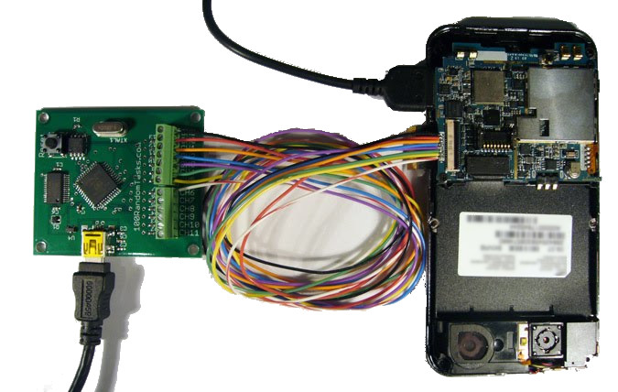
Debugging a Mobile Phone

Slide 51
Stub Debugger
If you have a spare serial port, you can write a stub debugger:
Minimum code to read/write memory and registers
Requires a few kB of flash memory
Needs access to UART or SPI for communication
Needs to hook into some interrupts
A real debugger on your PC will interface with the stub debugger. Drawbacks:
Functionality often very limited
Needs modifications of your embedded software

Slide 52
Simulators
Run your software in a simulator, debugger connects to the simulator.
Advantages:
Unlimited debugging power!
No hardware needed
Can run faster than real hardware
Very easy to automate
Drawbacks:
Simulators may not be perfectly accurate
No access to peripherals, or:
System as a whole is different than the real system

Slide 53
Tools for Continuous Integration

Slide 54
Continuous Integration
Goals:
Automate as much as possible.
Always keep your project in a releasable state.
Well-known examples::
Jenkins
Atlassian Bamboo
Travis CI
GitLab CI

Slide 55
Continuous Integration
Commit
Push
Compile
Build Packages
Build Documentation
Run Tests
Success
Send Alert!
Ship it!

Slide 56
The End

Slide 57
Miscellaneous Tools

Slide 58
Miscellaneous Tools
Issue trackers (bugs, project planning etc) Bugzilla, JIRA
Code formatters Indent, Clang-format, Astyle
Fuzzers AFL
Documentation generators Doxygen

